Slide 1
Storage Classes in C
Nida Munawar

Slide 2
Storage Classes
To fully define a variable one needs to mention not only its ‘type’ but also its ‘storage class’.
In other words, not only do all variables have a data type, they also have a ‘storage class’.
storage classes have defaults, If we don’t specify the storage class of a variable in its declaration,
There are basically two kinds of locations in a computer where such a value may be kept—
Memory and CPU registers.
It is the variable’s storage class that determines in which of these two locations the value is stored.

Slide 3
Storage Classes
Moreover, a variable’s storage class tells us:
(a) Where the variable would be stored.
(b) What will be the initial value of the variable, if initial value is
not specifically assigned.(i.e. the default initial value).
(c) What is the scope of the variable; i.e. in which functions the
value of the variable would be available.
(d) What is the life of the variable; i.e. how long would the
variable exist.

Slide 4
Storage Classes
There are four storage classes in C:
(a) Automatic storage class
(b) Register storage class
(c) Static storage class
(d) External storage class

Slide 5
Automatic Storage Class
The features of a variable defined to have an automatic storage class are as under:
Storage − Memory.
Default initial value − An unpredictable value, which is often called a garbage value.
Scope − Local to the block in which the variable is defined.
Life − Till the control remains within the block in which the variable is defined.

Slide 6
Automatic Storage Class
main( )
{
auto int i, j ;
printf ( "\n%d %d", i, j ) ;
}
The output of the above program could be...
1211 221
where, 1211 and 221 are garbage values of i and j. When you run this program you may get different values, since garbage values are unpredictable

Slide 7
Scope and life of an automatic variable is illustrated in the following program.
main( ){
auto int i = 1 ;
{
auto int i = 2 ;
{
auto int i = 3 ;
printf ( "\n%d ", i ) ;
}
printf ( "%d ", i ) ;
}
printf ( "%d", i ) ;
}

Slide 8
Scope and life of an automatic variable is illustrated in the following program.
The output of the above program would be:
3 2 1
Note that the Compiler treats the three i’s as totally different variables, since they are defined in different blocks.
Once the control comes out of the innermost block the variable i with value 3 is lost,

Slide 9
Register Storage Class
The features of a variable defined to be of register storage class are as under:
Storage - CPU registers.
Default initial value - Garbage value.
Scope - Local to the block in which the variable is defined.
Life - Till the control remains within the block in which the variable is defined.

Slide 10
Register Storage Class
main( )
{
register int i ;
for ( i = 1 ; i <= 10 ; i++ )
printf ( "\n%d", i ) ;
}
A value stored in a CPU register can always be accessed faster than the one that is stored in memory.

Slide 11
Static Storage Class
The features of a variable defined to have a static storage class are as under:
Storage − Memory.
Default initial value − Zero.
Scope − Local to the block in which the variable is defined.
Life − Value of the variable persists between different function calls.

Slide 12
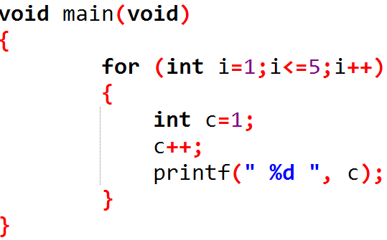
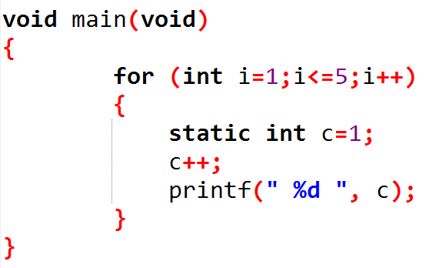
Static Storage Class

Slide 13
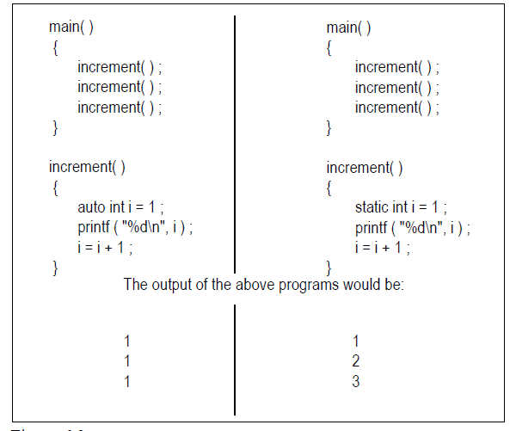
difference between the automatic and static storage classes

Slide 14
Static Storage Class
Like auto variables, static variables are also local to the block in which they are declared. The difference between them is that static variables don’t disappear when the function is no longer active. Their values persist. If the control comes back to the same function the static variables have the same values they had last time around.
In the above example, when variable i is auto, each time increment( ) is called it is re-initialized to one. When the function terminates, i vanishes and its new value of 2 is lost. The result: no matter how many times we call increment( ), i is initialized to 1 every time.
On the other hand, if i is static, it is initialized to 1 only once. It is never initialized again. During the first call to increment( ), i is incremented to 2. Because i is static, this value persists. The next time increment( ) is called, i is not re-initialized to 1; on the contrary its old value 2 is still available

Slide 15
External Storage Class
The features of a variable whose storage class has been defined as external are as follows:
Storage − Memory.
Default initial value − Zero.
Scope − Global.
Life − As long as the program’s execution doesn’t come to an end.
External variables are declared outside all functions, yet are available to all functions that care to
use them.

Slide 16
External Storage Class
int i ;
main( ){
printf ( "\ni = %d", i ) ;
increment( ) ; increment( ) ; decrement( ) ; decrement( ) ;
}
increment( ){
i = i + 1 ;
printf ( "\non incrementing i = %d", i ) ;}
decrement( ){
i = i - 1 ;
printf ( "\non decrementing i = %d", i ) ;}

Slide 17
External Storage Class
The output would be:
i = 0
on incrementing i = 1
on incrementing i = 2
on decrementing i = 1
on decrementing i = 0

Slide 18
External Storage Class
Look at the following program.
int x = 21 ;
main( ){
extern int y ;
printf ( "\n%d %d", x, y ) ;
}
int y = 31 ;
Here, x and y both are global variables. Since both of them have been defined outside all the functions both enjoy external storage class.

Slide 19
what will be the output of the following program?
int x = 10 ;
main( ){
int x = 20 ;
printf ( "\n%d", x ) ;
display( ) ;
}
display( )
{
printf ( "\n%d", x ) ;
}
First print 20 because its local to the fuction and then the global value of 10.

Slide 20
External Storage Class
Here x is defined at two places, once outside main( ) and once inside it. When the control reaches the printf( ) in main( ) which x gets printed? Whenever such a conflict arises, it’s the local variable that gets preference over the global variable. Hence the printf( ) outputs 20. When display( ) is called and control reaches the printf( ) there is no such conflict. Hence this time the value of the global x, i.e. 10 gets printed.

